Slide 1
Panasonic System Networks Vietnam
Procurement group
FREE LOCATION PROJECT
FY2023-FY2024

Slide 2
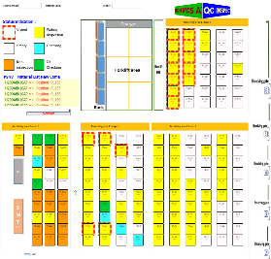




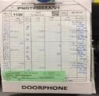




SUMMARY MCS PROJECT FLOW
2/10
① RECEIVING
② STORING
③ KITTING
④ SUPPLY
Receiving is not indicated on SAP
Manual print receiving card manual find & paste
Manual back flush
Manual control position by Excel file
Manual find location to store
Manual record INPUT qty to stock card
Manual transfer on SAP another store
Manual find location to kitting
Manual record OUTPUT qty to stock card
Manual control FIFO when kitting
Manual control kitting position
Auto transfer
Manual find trolley put material
CURRENT
Outside vendor
-Local 76% have barcode-
-Oversea 56% have barcode-
Receiving E-map
Storage E-map
Kitting area E-map
❹
12h
8h
6h
Add unit
location code
each position
Kitting
Kitting
Prepare OK
Production line
PDA scan
➔direct print receiving card by mobile printer
Manual stock card
❶
X
Kitting
Kitting
Prepare OK
100% add barcode

❺
Add E-map kitting area
Add E-map storage
Storing
member
Kitting
member
FOSS
FOSS
FOSS
❸
Internal vendor
(PMD/OCS/FA)
-No have barcode-
❸
❸
❷
Add mobile printer
Auto backflush
Data synchronization
Data synchronization
❶ ❷ ❸

❸ ❹ ❺
❸ ❹
Manual Auto control position by E-map
Manual Auto find location to store
Manual Scan INPUT qty to unit barcode
Manual Auto transfer on SAP another store
Manual Auto find location to kitting
Manual Scan OUTPUT qty to unit barcode
Manual control FIFO by system
Manual Control kitting position by E-map
Proposal
Receiving is not indicated on SAP
Manual Auto print receiving card manual find & paste
Manual Auto back flush
Auto transfer
Manual Auto find trolley put material
AFTER
Benefit
∆2pax (1ME,1SC)
∆2pax
(2SC)
∆5pax
(2SC,2KA,1ME)
∆1pax
(1SC)

Slide 3

MAKE E-MAP MASTER
- How to improve efficiency by optimize moving way -
3/10
*Select the kind of material, the scope of using to apply the free location. After study we have 3 cases :
Case 1: Material Just in time delivery (Rate 30%) – NO NEED APPLY FREE LOCATION
Vendor
Receiving area
Capacity 500pallet/day
Storage
Free location
Kitting area
FA location
Non-moving
Non-moving
Non-moving
Line 1
Just in time delivery
150 pallet/day
Rate ~ 30 %
( carton, foam sheet..)
Slow moving
Slow moving
Slow moving
Over stock
Over stock
Over stock
10AM
8AM
6AM
Over stock
10AM
8AM
6AM
Over stock
Over stock
Moving part
Moving part
Moving part
Packing
process
No use free location
Direction keep kitting area nearest FA line
MCS supply
*signal light warning ”Andon” system
* Direction for PIC put material at kitting area nearest FA line.
Storing
member
FOSS
FOSS
PUS
*FOSS Auto connect SAP calculate, how to do storing this type.
*Material daily delivery
Q’ty using finish end of day.
-Vendor delivery type 179
-VMI delivery
-Jupiter transfer daily to PSNV
=>PUS will expand just in time delivery for vendor. FOSS calculate to direction for PIC put materials
at “kitting area”. This case “ no need free location” and inventory by FOSS system.
Case 1:MCS supply by demand of FA, signal light warning “Andon” system

Slide 4
MAKE E-MAP MASTER
- How to improve efficiency by optimize moving way -
4/10
Case 2. Material combine delivery and every day using (Rate 5%) – NO NEED APPLY FREE LOCATION
Vendor
Receiving area
Capacity 500pallet/day
Storage
Free location
MCS Kitting area
FA location
Non-moving
Non-moving
Non-moving
Line 1
Sub material
10 pallet/day
Rate ~2 %
(pallet,stamp,
Solder,polibag)
Daily using
25 pallet/day
Rate ~5 %
(Pin, screw,
manual book…)
Slow moving
Slow moving
Slow moving
Over stock
Over stock
Over stock
Over stock
Moving
Part
Moving
Part
kitting 1 times/day
Option 2
* MCS supply by demand of FA
signal light warning “Andon” system
Option 1
Current, MCS already transfer to FA-sub center store
No use free location
Direction for PIC put material at
FA-sub center store
MCS & FA will discussion which location to keep material every day using.
Option 1: FA decision keep FA sub center store,
Option 2: FA not enough space, MCS will keep storage and kitting 1 times/day for FA
FOSS
FOSS
*FOSS Auto connect SAP calculate, how to do storing this case.
PUS
*Calculate material
every day using:
- Frequent
- Q’ty using
- Q’ty delivery
=>MCS & FA will discussion which location to keep material every day using.
This one “ no need Free location” and inventory by FOSS system.
Option 2.MCS supply by demand of FA, signal light warning “Andon” system

Slide 5
MAKE E-MAP MASTER
- How to improve efficiency by optimize moving way -
5/10
Case 3.Material long lead time (Rate 63%)
Vendor
Receiving area
Capacity 500pallet/day
Storage
Free location
MCS Kitting area
FA location
Non moving
Non-moving
Non-moving
line 1
Slow moving
Slow moving
Slow moving
Line 1
10AM
Line 1
8AM
Material long lead time
315 pallet/day
Rate ~ 63 %
( Oversea ,VMI, over stock…)
Over stock
Over stock
Over stock
line 2
Line 2
10AM
Line 2
8AM
Over stock
Over stock
Over stock
Line 3
10AM
Line 3
8AM
line 3
Moving part
Moving part
Moving part
E-map suggest location
blank can storing
E-map suggest location kitting nearest
Direction for PIC
put material at MCS free location storage
PIC
Storing
Kitting
member
FOSS
FOSS
*FOSS Auto connect SAP calculate, how to do storing this case.
PUS
*Calculate material type:
- long lead time
- Non-moving
- Slow moving
- Over stock
Which materials long lead time ,FOSS will calculate to direction for PIC storing put on free location area:
*Q’ty daily using keep on 1st layer
*Q’ty over stock keep 2nd layer & 3rd layer.
* Part slow moving, non-moving keep on the top rack
This case ”we will apply free location”

Slide 6
MAKE E-MAP MASTER
- How to improve efficiency by optimize moving way -
6/10
Idea improve for 3 cases : Transfer kitting area for FA control
Vendor
Receiving area
Capacity 500pallet/day
Storage
Free location
Kitting area
FA location
Non-moving
Non-moving
Non-moving
line 1
Case 1:
Just in time delivery
Case 2: Material combine delivery and every day using
Case 3 :Material long list time
Slow moving
Slow moving
Slow moving
Line 1
10AM
Line 1
8AM
Over stock
Over stock
Over stock
line 2
Line 2
10AM
Line 2
8AM
Over stock
Over stock
Over stock
Line 3
10AM
Line 3
8AM
line 3
Moving
Part
Moving
Part
Moving
Part
E-map suggest location
storage
E-map suggest location kitting nearest
FA control
Direction for PIC
put material at MCS free location storage
PIC
Storing
PIC
Kitting
No need signal light warning “Andon” system
FOSS
FOSS
*FOSS Auto connect SAP calculate, how to do storing this case.
PUS
*Calculate material type:
Case 1:Just in time delivery
Case 2: Material combine delivery and every day using
Case 3 :Material long list time
We studying this idea when transfer kitting area for FA control :
Good point: ?
Weak point: ?

Slide 7
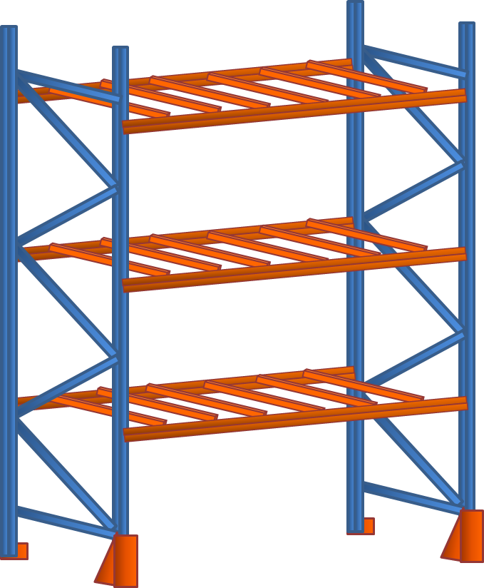
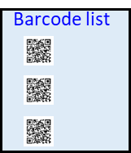

1.B001.4.01
MCS FREE LOCATION E-MAP SETUP
- Rule for naming location -
7/10
1 : PSNV first floor
S : Small rack
P : only pallet
1.B001.4.02
1.B001.4.01
B : Big rack
B001
1
001 : Q’ty head rack
1.B001.3.02
4 : Layer of rack
1.B001.3.01
01 : Unit location
1.B001.2.02
1.B001.2.01
LOCATION NAME
1.B001.1.01
1.B001.1.02
=> We issue naming rule as the content above and using unit barcode to control all free location

Slide 8

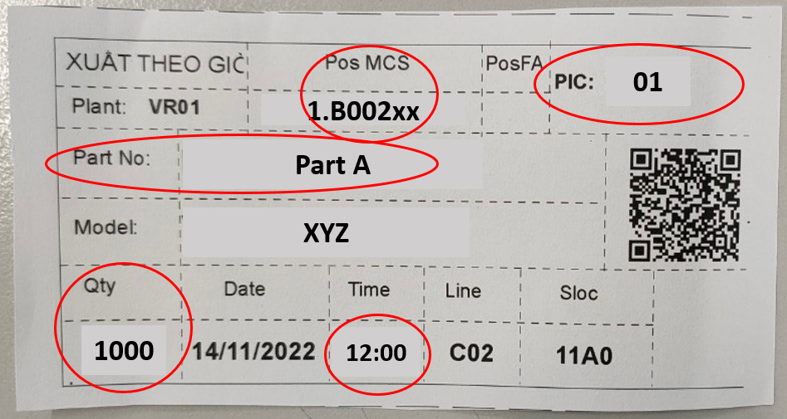
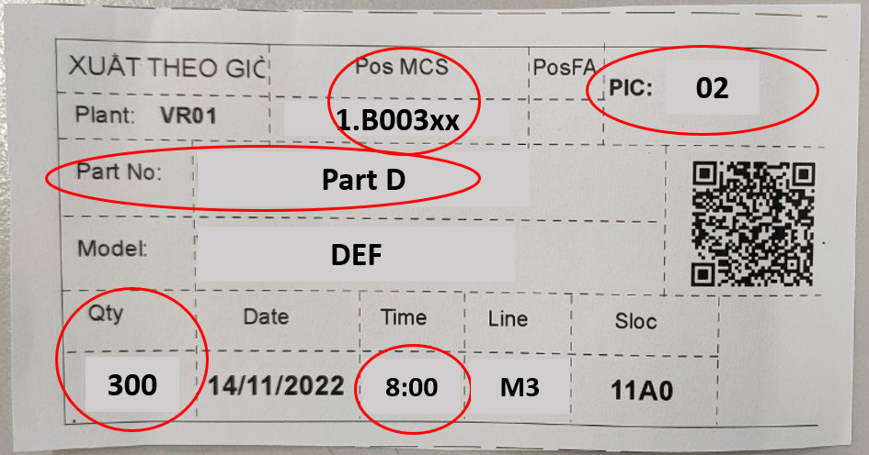
MCS FREE LOCATION E-MAP SETUP
- Rule for storing & kitting material -
8/10
Slow moving
Non moving
- Vendor indicate
E-map no need guide
➔ MCS control
Slow/non
moving
4th layer
E-map no need guide
➔ MCS control
Over
stock
Over stock
3rd layer
For STORING
Spare
Over
stock
E-map guide after main location full
➔Nearest part’s main location
2nd layer
Moving
part
Big part
Heavy part
Daily using
E-map priority guide first
1st layer
=> We choose materials apply free location and make ground rule for put material on rack , how to do system understand location blank or full
FOSS
Part A
500pcs
Part B
Part C
Plan kitting
part A: 1300pcs
FIFO
Zone 1
PIC 01
Part A
500pcs
Part E
Part F
For KITTING
Part card indicate:
- PIC (fix by zone location)
- Qty
- Time (FIFO based)
Part G
Part D
300pcs
Part card Printer
Paper size: A7
Zone 2
Part H
500pcs
Part I
PIC 02
=>Each PIC kitting will control 1 zone at free location, Part card Printer paper size: A7 (reduce time cut & separate )

Slide 9

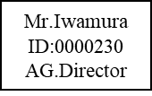








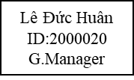
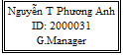
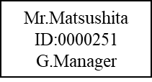

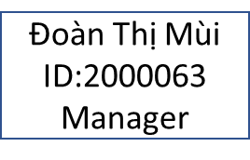
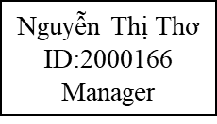
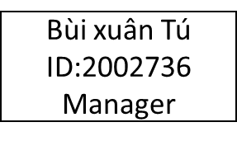

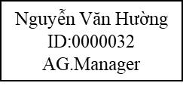




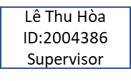
FREE LOCATION PROJECT ORGANIZATION CHART
9/10
Organization chart:
ADVISOR
ADVISOR
ADVISOR
MCS
PUS
IT
IQC
FA
PMD
OCS
Leader
Development
SAP
5 Members
(New)
- Building logical system
- Add barcode for
all current vendor
- Study logical system, investment
-All transection must issue & paste barcode label
-All transection must issue & paste barcode label
-PMD auto Back flush
-Rainbow issue & paste barcode label
- Building logical E-map
- Give suggestions, solution , equipment
- Combine sections to
follow schedule
- Apply barcode for new vendor
-Issue & paste barcode label
- Develop all function on schedule
-IQC scan auto transfer NG Sample, rohs, alcohol test.
-FA auto Back flush (welding ,ultrasonic…)
- Combine sections to
follow schedule

Slide 10

JOB SCOPES
10/10
MCS make workflow: Jul
Discuss IT workflow : Aug – begining Sept to make IT job scope and fix project detail scheme
Preparation & Analyses progress:
No | Content | PIC | Concerning section | Schedule |  |  |  |  |  |  |  |  |  |  |  |  |  |  |  |  |  |  |  |  |  |  |  |  |  |  |  |  |  |  |  | Status
 |  |  |  | Aug.2023 |  |  |  | Sep.2023 |  |  |  | Oct.2023 |  |  |  | Nov.2023 |  |  |  | Dec.2023 |  |  |  | Jan.2024 |  |  |  | Feb.2024 |  |  |  | Mar.2024
 |  |  |  | W2 | W3 | W4 | W5 | W1 | W2 | W3 | W4 | W1 | W2 | W3 | W4 | W1 | W2 | W3 | W4 | W1 | W2 | W3 | W4 | W1 | W2 | W3 | W4 | W1 | W2 | W3 | W4 | W1 | W2 | W3 | W4
1 | General project scheme | MCS | IT, ACS, HR |  |  |  |  |  |  |  |  |  |  |  |  |  |  |  |  |  |  |  |  |  |  |  |  |  |  |  |  |  |  |  |  | Done
2 | Flow 1: Receiving | MCS & IT | PUS, PMD, OCS |  |  |  |  |  |  |  |  |  |  |  |  |  |  |  |  |  |  |  |  |  |  |  |  |  |  |  |  |  |  |  |  | Progress
3 | Flow 2: Storing | MCS & IT | QC |  |  |  |  |  |  |  |  |  |  |  |  |  |  |  |  |  |  |  |  |  |  |  |  |  |  |  |  |  |  |  |  | Progress
4 | Flow 3: Kitting & Supply | MCS & IT | FA |  |  |  |  |  |  |  |  |  |  |  |  |  |  |  |  |  |  |  |  |  |  |  |  |  |  |  |  |  |  |  |  | Progress
5 | Flow 4: Inventory | MCS & IT |  |  |  |  |  |  |  |  |  |  |  |  |  |  |  |  |  |  |  |  |  |  |  |  |  |  |  |  |  |  |  |  |  | Progress
 |  |  |  |  |  |  |  |  |  |  |  |  |  |  |  |  |  |  |  |  |  |  |  |  |  |  |  |  |  |  |  |  |  |  |  | Progress
6 | Summary Project: - Method - Resources: Equipment, Headcount, Cost,… - Time - ROI | MCS, IT, ACS, HR |  |  |  |  |  |  |  |  |  |  |  |  |  |  |  |  |  |  |  |  |  |  |  |  |  |  |  |  |  |  |  |  |  | Progress
7 | Report BOM | MCS, IT, ACS, HR |  |  |  |  |  |  |  |  |  |  |  |  |  |  |  |  |  |  |  |  |  |  |  |  |  |  |  |  |  |  |  |  |  | Progress
8 | Systems Design & Implement | IT | MCS, PUS |  |  |  |  |  |  |  |  |  |  |  |  |  |  |  |  |  |  |  |  |  |  |  |  |  |  |  |  |  |  |  |  | Progress
10-Aug
11-Aug
Weekly meeting MCS-IT Thu 3.15 pm
18-Aug
Discuss new concept
of storing
25-Aug
31-Aug
07-Sep

